Slide 1
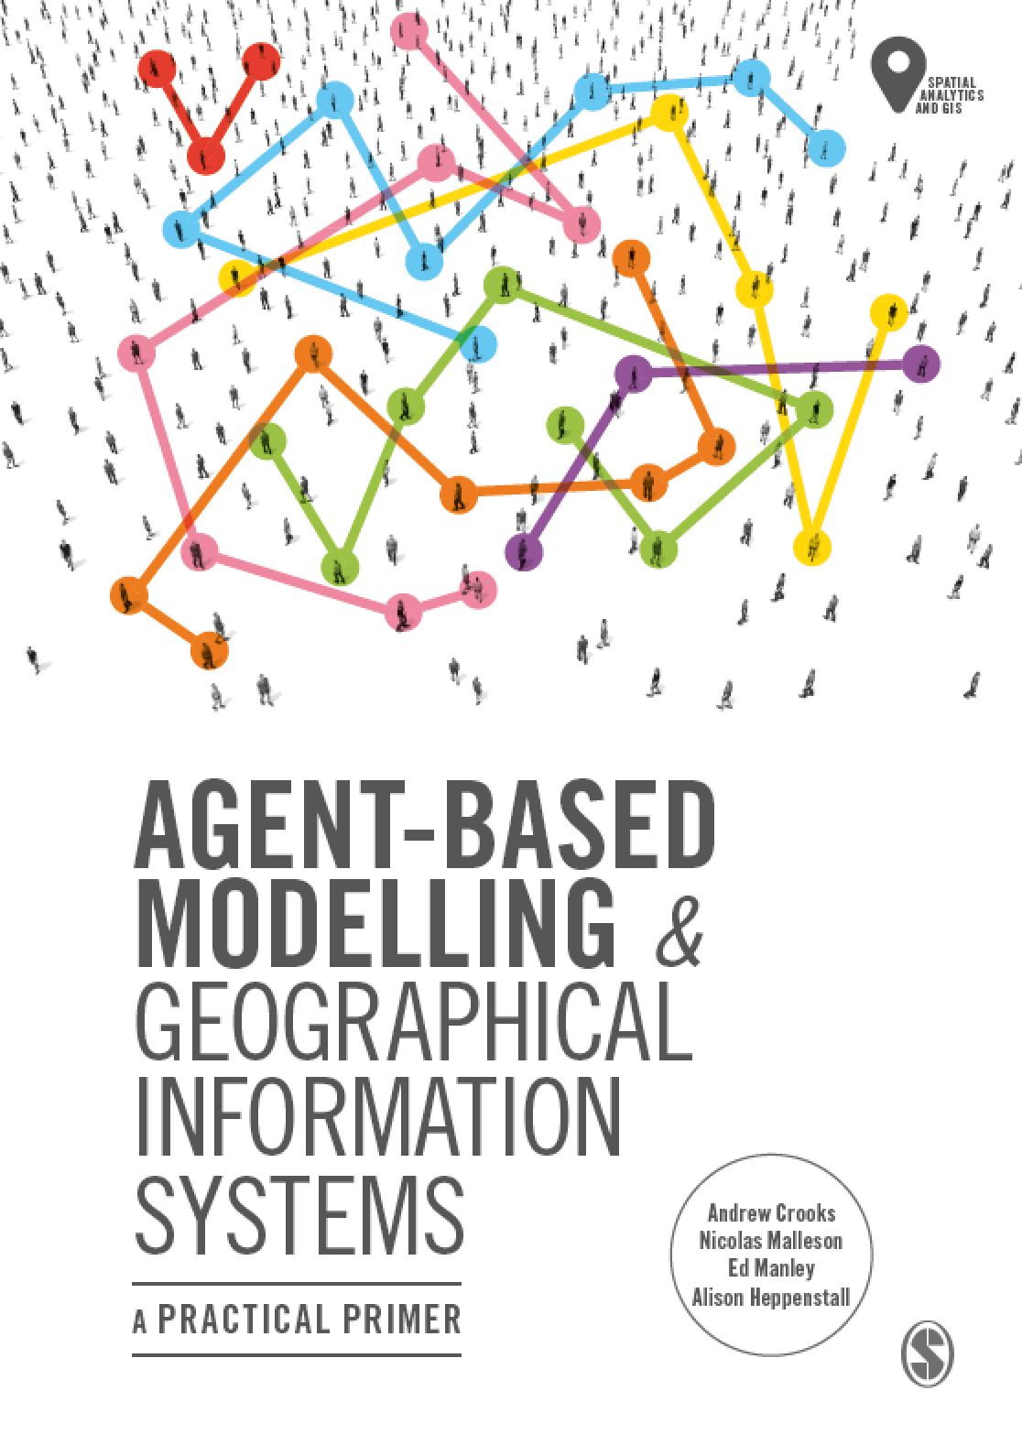
Chapter 6
Integrating Agent-Based Modelling and GIS
Notes:
Building on previous chapters outlining the fundamentals of GIS and agent-based modelling, what are the benefits to linking these approaches? How is this undertaken? This chapter will explain loose and tight coupling critiquing the relative advantages and disadvantages of both. We present an overview of open source toolkits that can be used for the creation of geographically explicit agent-based models before providing a critical look at where and how GIS and ABM should be combined offering practical advice on best practice.

Slide 2
Learning Objectives
By the end of this chapter, students will be able to:
Understand the benefits of linking GIS and agent-based modeling,
Moreover, how this linkage is undertaken
i.e. loose and tight coupling
Know what open source toolkits that can be used for the creation of geographically explicit agent-based models
How raster and vector data can be utilized in models via example applications.

Slide 3
Introduction
Bringing GIS and ABM approaches together allows modelers to think about how objects or agents and their aggregations interact and change in space and time.
For GIS users, it provides the ability to model the emergence of phenomena through individual interactions of features within a GIS over time and space.
GIS provides the ability to monitor the world, pulling together detailed information on areas, but it is unable to give insight into decision-making frameworks,
E.g. why people choose to live in such areas
Through the integration of GIS and agent-based modelling we can capture both this.

Slide 4
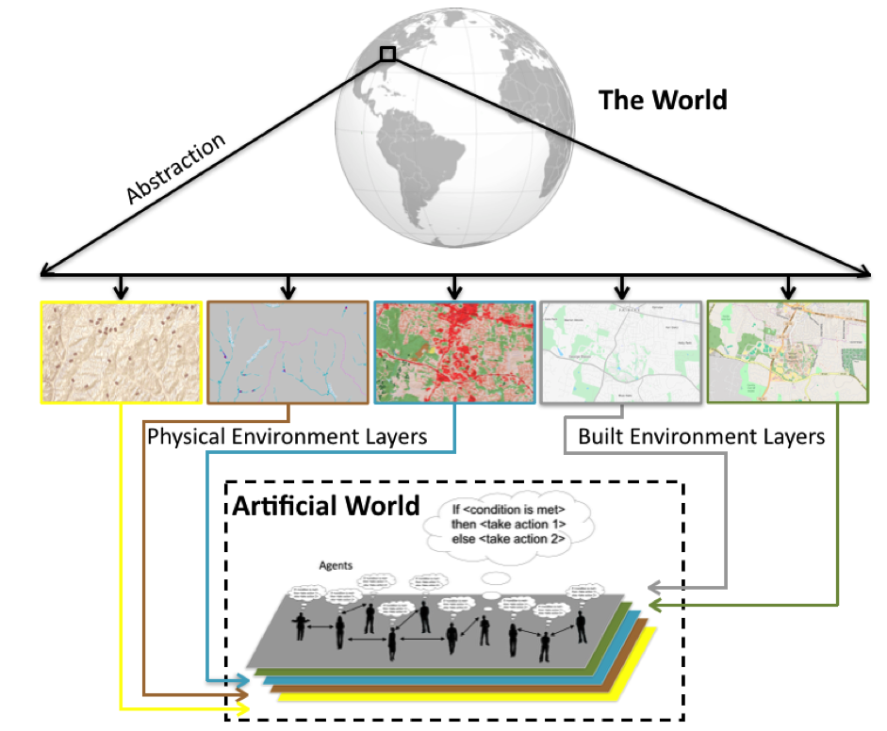
Creating an ‘Artificial World’ from GIS Data
Figure 6.1: Abstracting from the “real” world into a series of layers to be used in the artificial world for which to base the agent-based model upon.
Notes:
The simplest way to visualize the integration of geographical data and agent-based modelling is by taking a GIS view of the world

Slide 5
Space in agent-based models
Space within agent-based models serves two purposes: firstly, it contains the agents; and secondly, it defines the spatial relationships between the agents and controls their movement. Spatial data allows us to:
Document the macro-phenomena.
Inform micro-level process modelling – drivers of change (e.g. calculating accessibility indices’ impact on house prices or analysis of land-use histories).
Derive maps of the agents’ environments (e.g. of physical networks such as roads for the agents to inhabit).
Derive demographic variables for agent populations.
Use macro-data for model validation, thus providing an independent test of the micro-level processes encoded in the model.

Slide 6
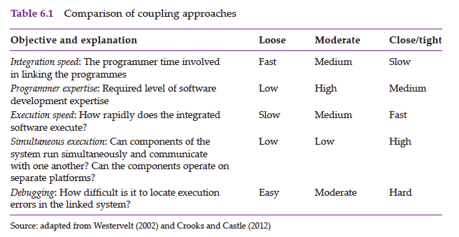
Coupling and Embedding GIS and Agent-based Models
Loose coupling is the approach we take in this book and is also the norm in many agent-based modelling toolkits

Slide 7
Tools for Constructing and Developing Agent-based Models
Traditionally the building of agent-based models required development from scratch using conventional programming languages such as C++, Java and Python.
Which can be time consuming
However, over the years several agent-based modelling toolkits have been developed which allow for more ease with respect to the development of agent-based models
Toolkits reduce the burden that modelers face in programming parts of a simulation that are not content-specific (e.g. GUIs, data import and export, visualization/display of the model).
Toolkits also increase the reliability and efficiency of the model, because complex parts have often been created and optimized by professional developers as standardized modelling functions

Slide 8
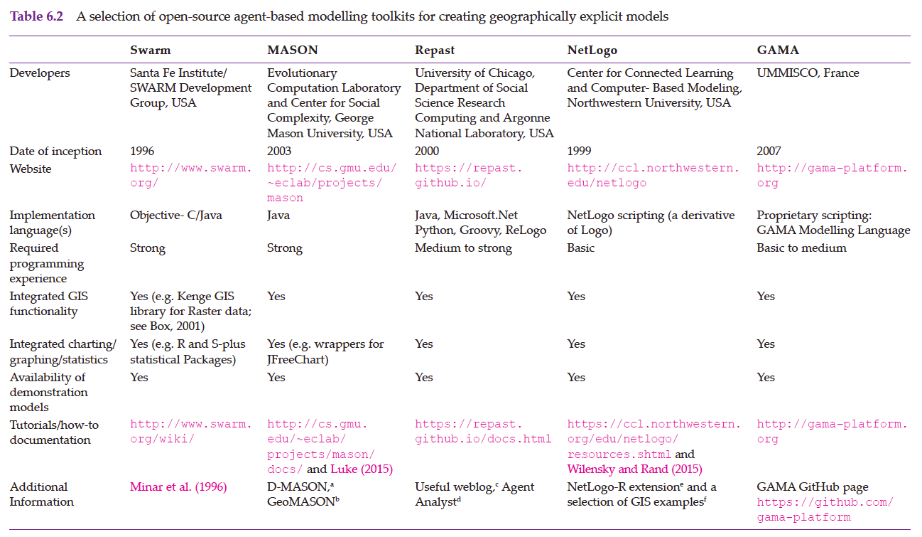
Tools for Constructing and Developing Agent-based Models

Slide 9
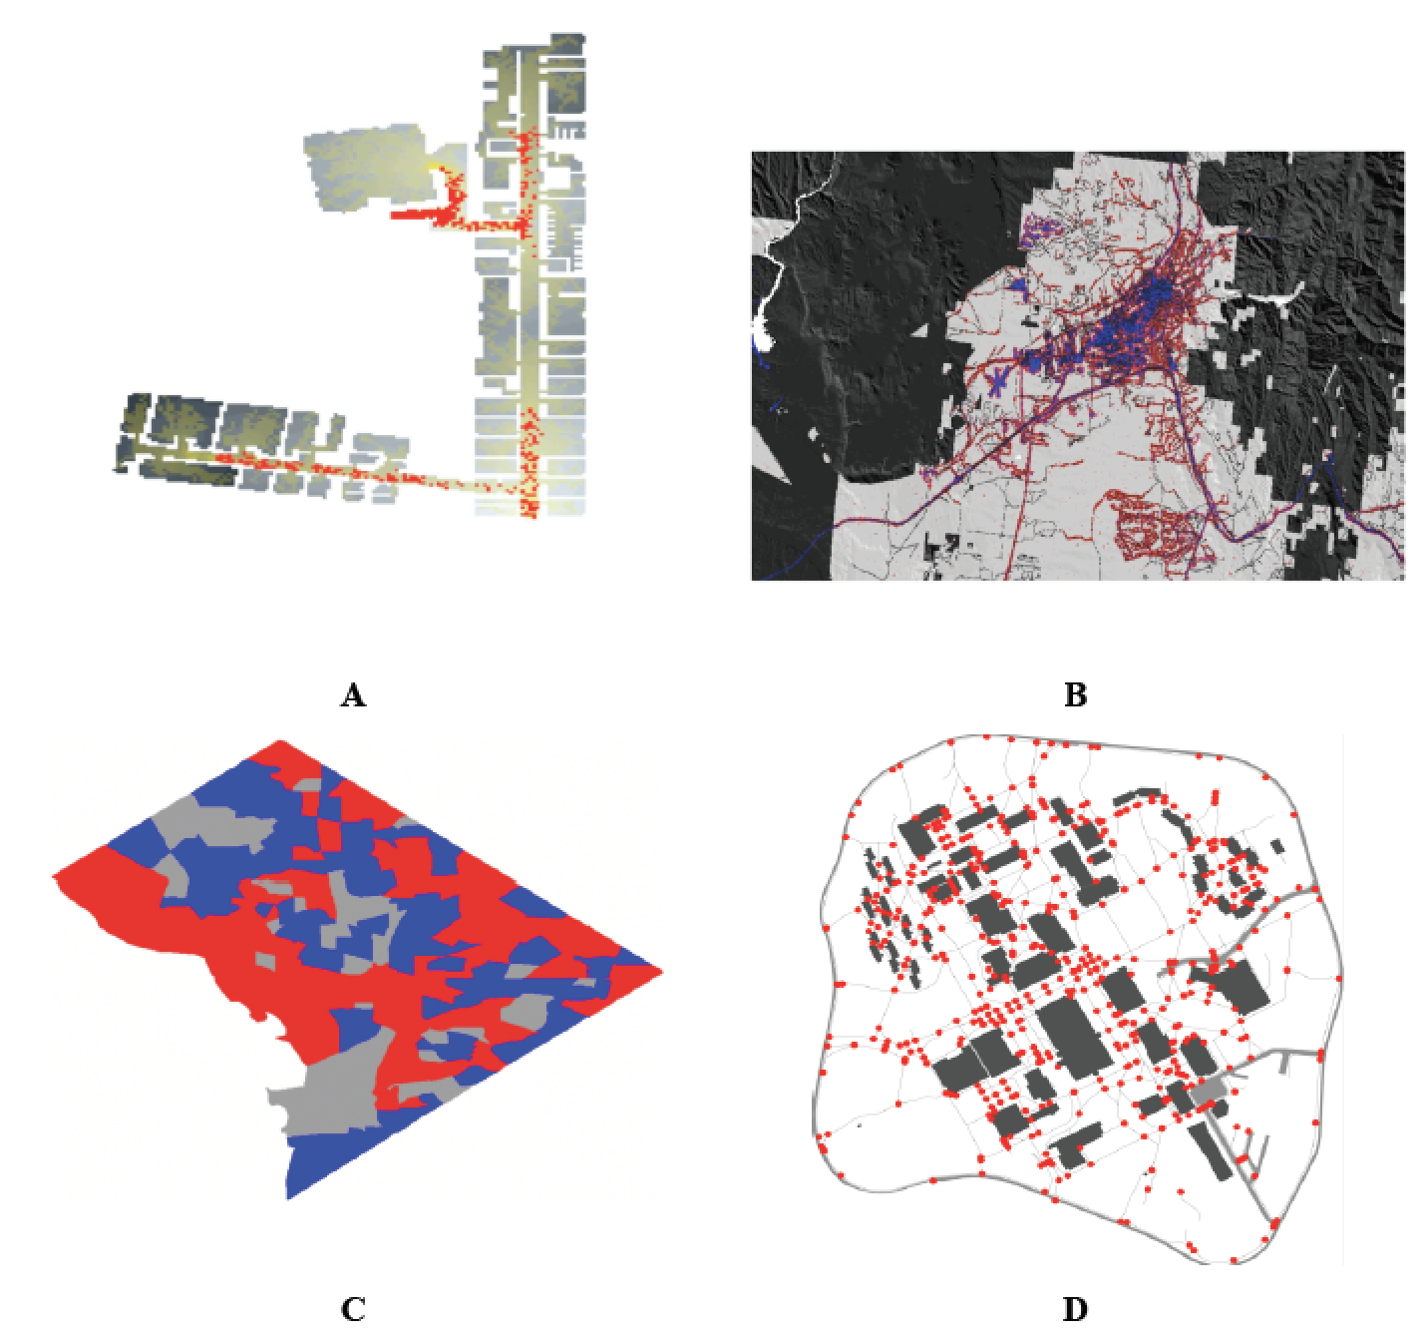
A Selection of MASON Spatial Models
Agents (red) exiting a building based on raster data and the resulting trails (yellow).
An urban growth model where red areas represent new developments.
A Schelling type of model using census areas in Washington DC as its spatial environment.
Agents (red circles) moving along on sidewalks (grey lines).

Slide 10
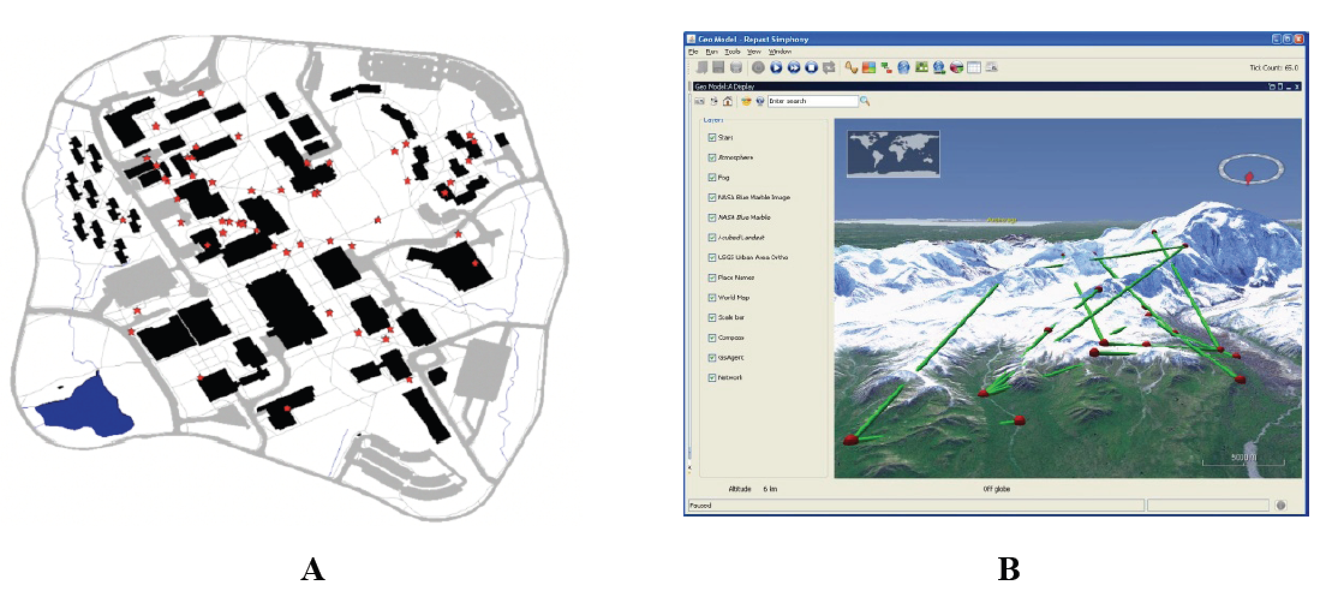
A Selection of Repast Models
Examples of vector agent-based models in Simphony. (A) Agents (red stars) moving along on sidewalks (grey Lines). (B) An agent-based model overlaid on NASA world wind (Source: Repast, 2016)

Slide 11
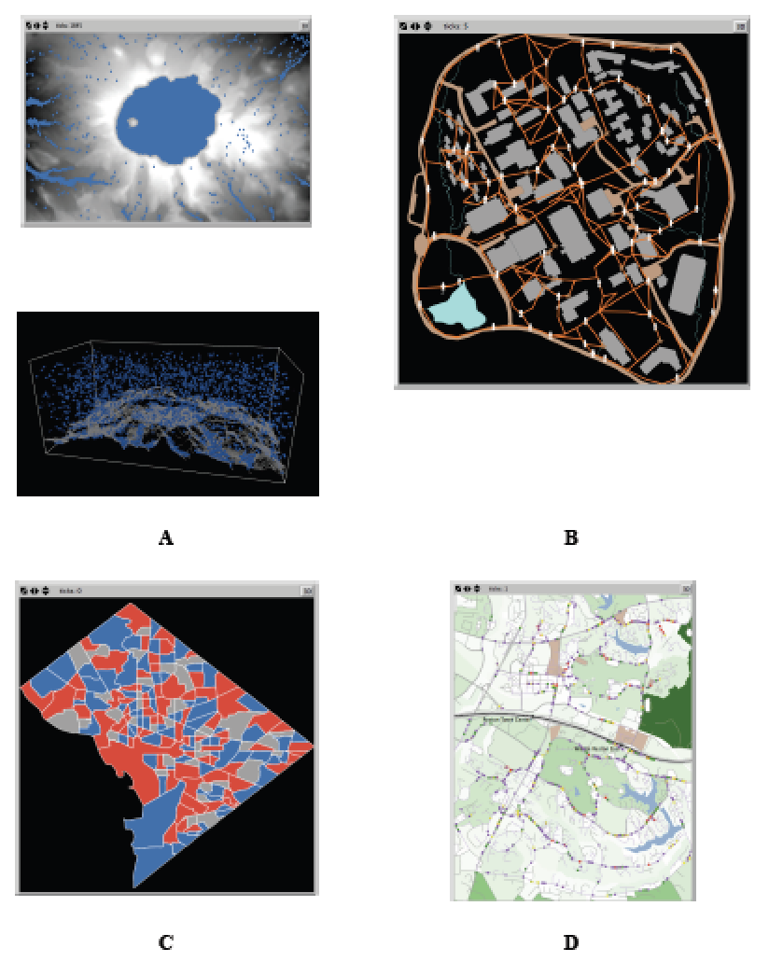
A Selection of NetLogo Models
A selection of geographically explicit agent-based models utilizing NetLogo
Rainfall where rain (blue) falls and flows to a lower elevation based on a digital elevation model captured in 2 and 3D.
Agents (white) moving along on sidewalks (orange).
Schelling type model using census areas in Washington DC as their spatial environment.
Commuting along a road network.

Slide 12
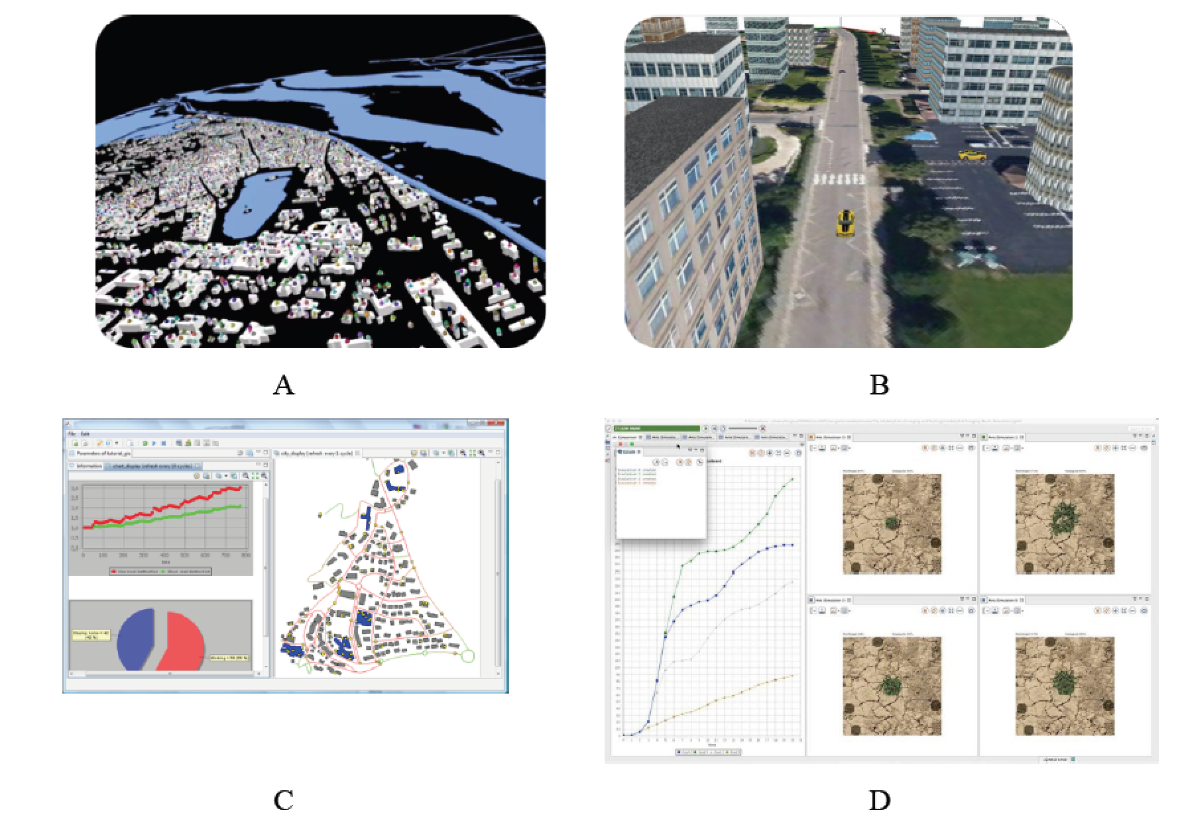
A Selection of GAMA Models
GAMA platform: Advanced visualization of simulations (A and B). (C) Built in charting and functions. (D) User interface (Source: GAMA, 2016).

Slide 13
Integrating GIS Data into Agent-Based Models
Space in agent-based models can range from abstract, as in the Schelling model, to geographically explicit either through the use of vector or raster data structures.
Traditionally many researchers focused on cell-based models, while more recently vector-based models have emerged, as well as combinations of the two.
The way in which space is represented within a model will depend on the data model used (e.g. raster or vector).
Models using Raster data
Often are termed discrete;
I.e. the movements of agents are restricted to a discrete number of cells.
Geometry can be represented only coarsely, and neighborhoods are often based on cell neighbors
Models using Vector data
Often termed continuous;
i.e. agents’ locations, and those of other objects, can take any location (within the bounds of precision offered by floating-point numbers).
Allows s for a more precise representation of geometry. Agents’ neighborhoods in continuous space are often based on a buffer of a specified distance around them.

Slide 14
NetLogo’s GIS extension
NetLogo’s GIS extension provides support for reading both vector data (in the form of ESRI shapefiles) and raster data (in the form of ESRI ASCII grid files).
The NetLogo documentation states: ‘This extension adds GIS (Geographic Information Systems) support to NetLogo. It provides the ability to load vector GIS data (points, lines, and polygons), and raster GIS data (grids) into your model.’
As with all NetLogo extensions, the model needs to ‘activate’ it with the following line at the beginning of the model code:
extensions[gis]

Slide 15
Using Raster Data in NetLogo
In cellular space models, the world is divided up into a series of cells (analogous to the raster data model)
In a cellular space, agents’ movements are restricted to one of these discrete cells.
E.g. The Schelling Segregation model
Generally all cells (or ‘patches’ in NetLogo speak) are the same shape.
Such a representation of space has similarities to that of cellular automata (CA) models
In cell-based models, an agent’s neighborhood is often calculated using Moore or von Neumann neighborhoods, or variations of these which can be weighted to account for distance from the agent .

Slide 16
Finding turtles or patches within von Neumann (8) or Moore (4) neighborhoods in NetLogo
;; Examples of finding neighbors in NetLogo (these are either patch or turtle context)
;; Ask the eight von Neumann neighboring patches to turn blue:
ask neighbors [ set pcolor blue ]
;; Ask all turtles on neighboring patches to turn brown
ask turtles-on neighbors [ set pcolor brown ]
;; Repeat, but this time using the Moore neighborhood
ask neighbors4 [ set pcolor blue ]
ask turtles-on neighbors4 [ set pcolor brown ]

Slide 17
Raster Model Examples: Urban Growth and Pedestrian Modelling

Slide 18
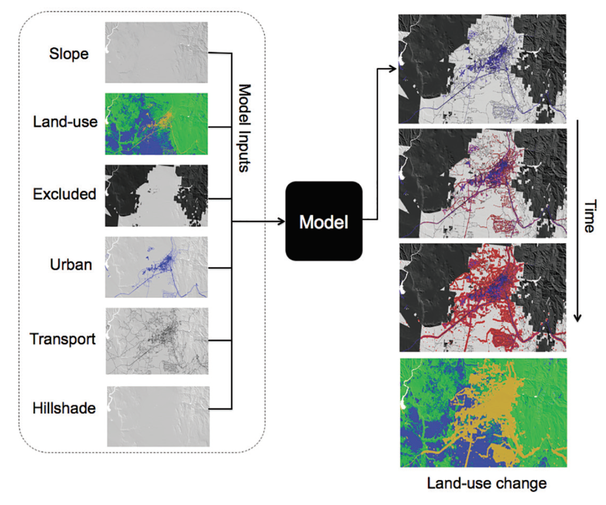
A SLEUTH-Type Model
Based on growth rules and coefficients as outlined in Clarke et al. (1997). In this example, the model is simulating the rates of land-use change
in Santa Fe, New Mexico.
Clarke, K. C., S. Hoppen, and L. J. Gaydos (1997). A Self-Modifying Cellular Automaton Model of Historical Urbanization in the San Francisco Bay Area. Environment and Planning B 24(2), 247{261.

Slide 19
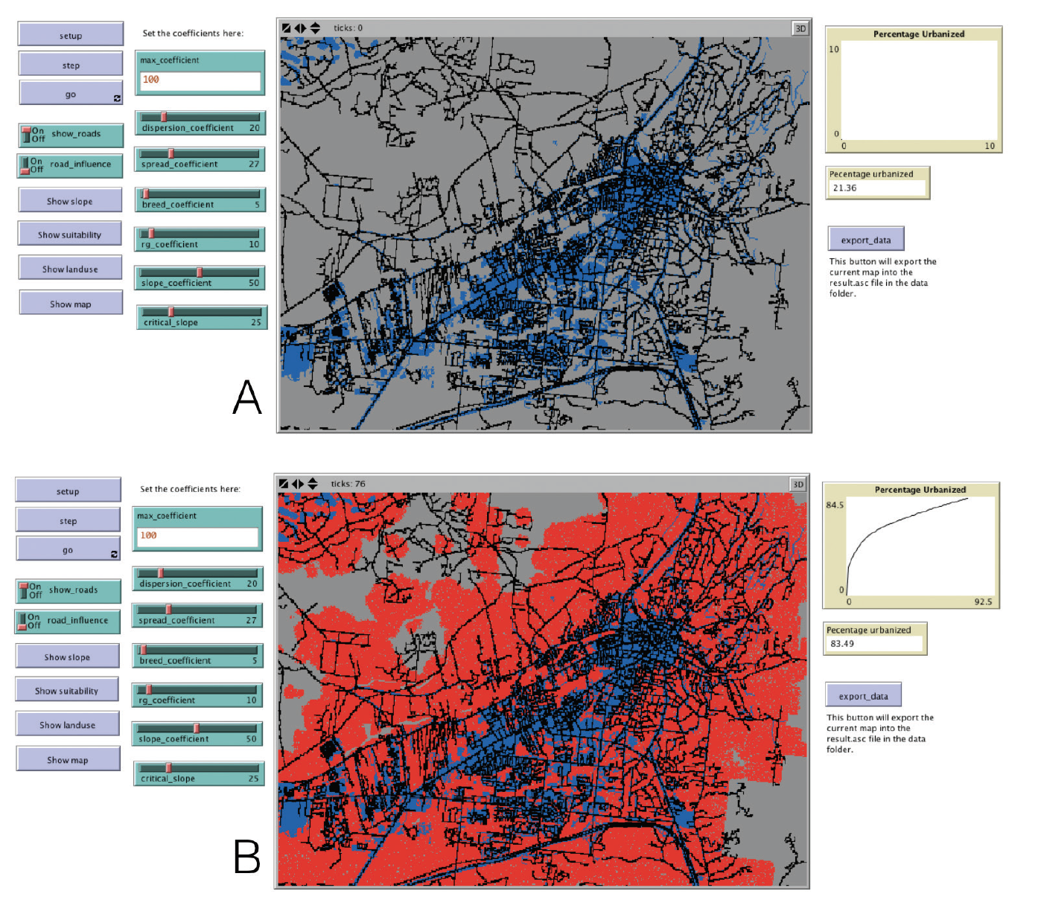
A Basic SLEUTH-Type Model
Model based on growth rules and coefficients driving the rates of land-use change stylized on Santa Fe, New Mexico implemented in NetLogo:
(A) initial conditions (blue cells);
(B) urban growth (red cells).
Click here to download the model

Slide 20
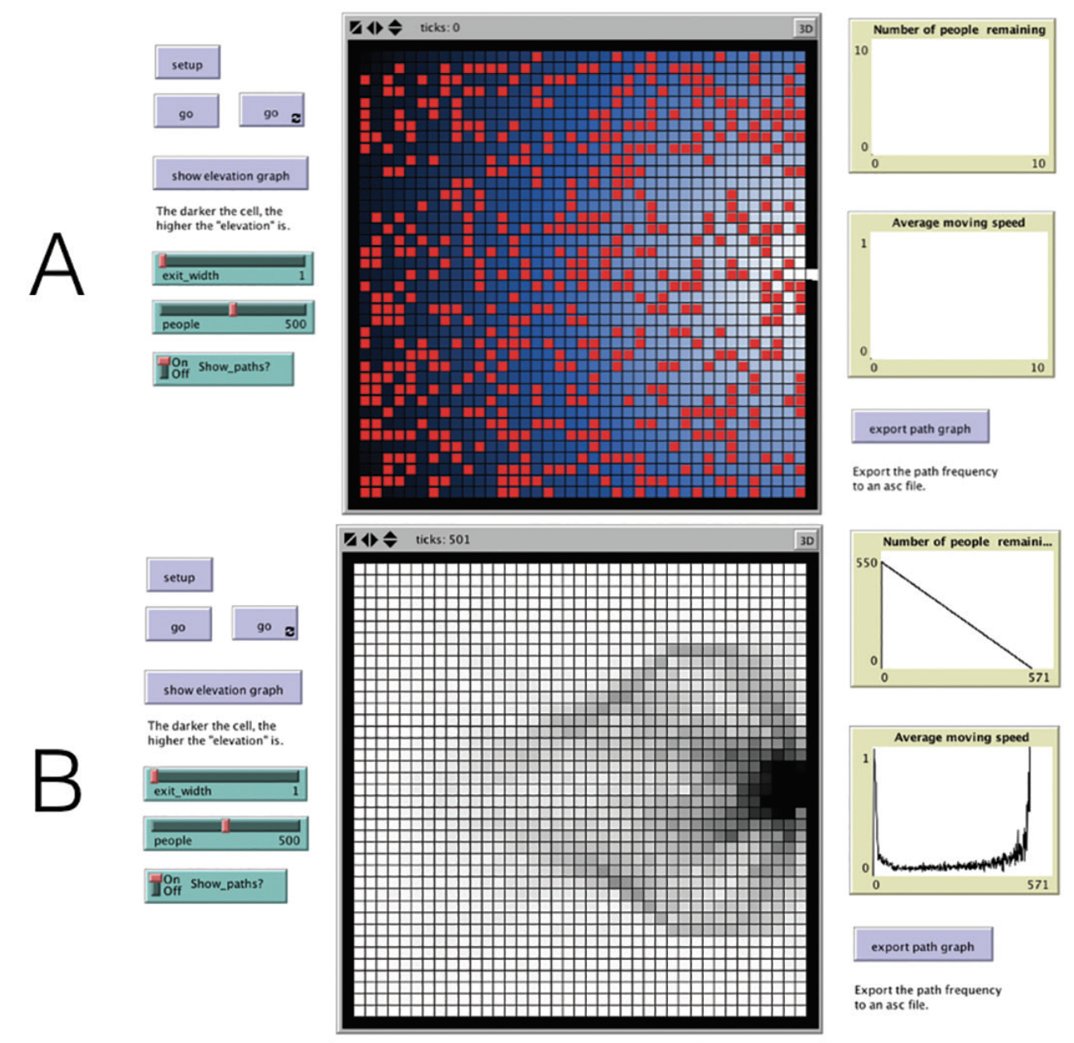
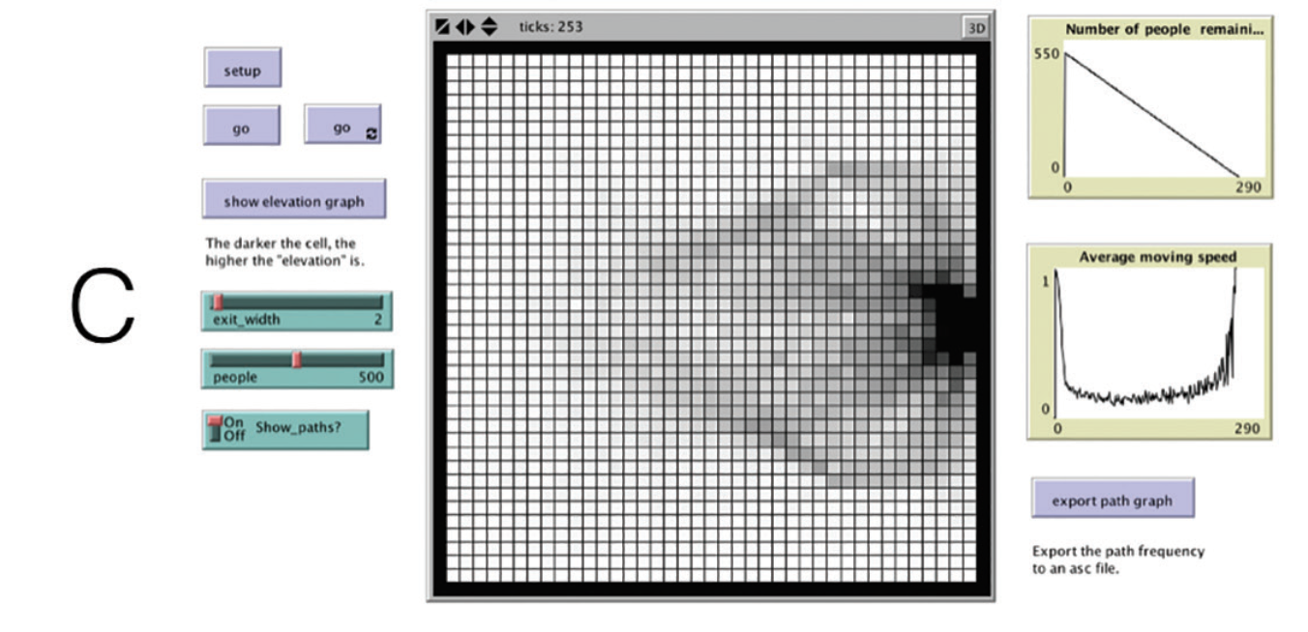
A Simple Pedestrian Evacuation Model where Agents are Exiting a Room
(A) initial starting conditions where the red dots represent agents and the blue represent a cost surface;
(B) pedestrian paths when the door is one cell wide,
(C) pedestrian paths when the door is two cells wide
Click here to download the model
Notes:
A simple pedestrian evacuation model where agents are exiting a room:
(A) initial starting conditions where the red dots represent agents and the blue represent a
cost surface;
(B) pedestrian paths when the door is one cell wide,
(C) pedestrian paths when the door is two cells wide

Slide 21
Code Example to move agents down a cost surface
ask turtles [
;; Decide which grid cell to move to. - ’elevation’ is the value of the cost surface. - ’count turtles-here * 9999999’ stops the agent from moving onto an occupied cell. The turtle wants to chose the neighboring
;; cell with the lowest elevation
let target min-one-of neighbors [
elevation + ( count turtles-here * 9999999)
]
;; If the free cell has a lower elevation than the current cell, move to it. Otherwise don’t do anything (stay still)
if [elevation + (count turtles-here * 9999999)] of target < [elevation] of patch-here [
face target
move-to target
]
]

Slide 22
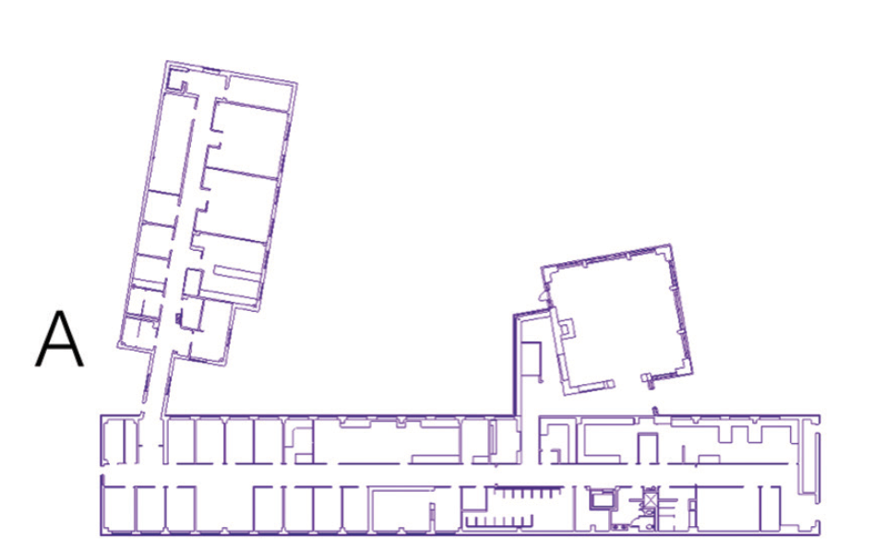
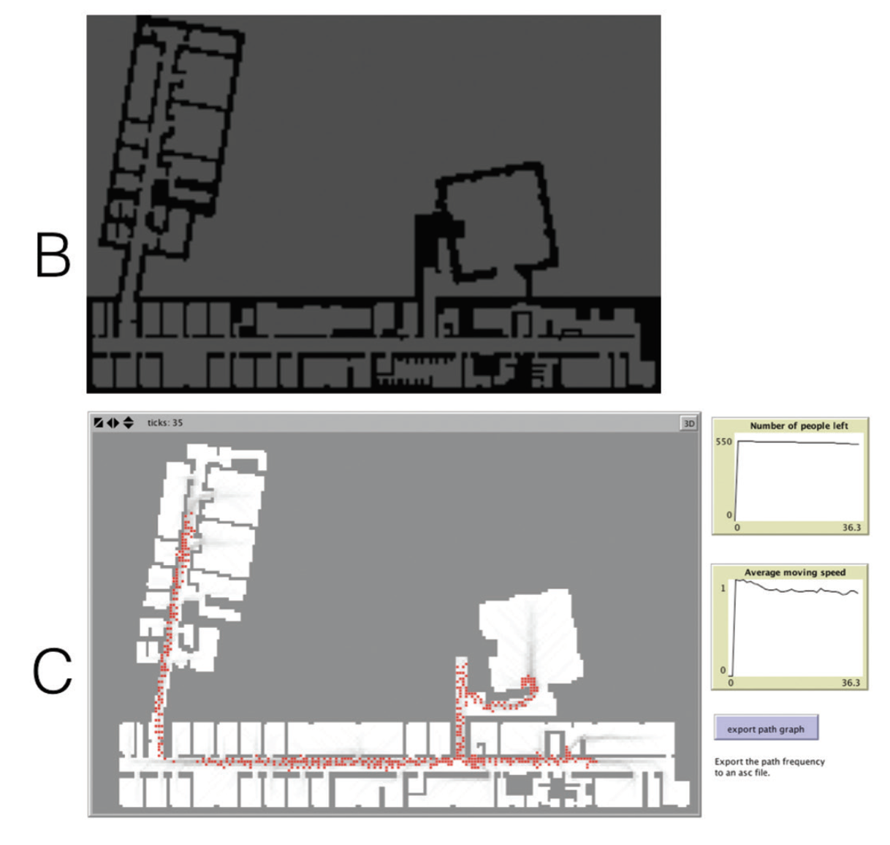
Pedestrian Modelling
Click here to download the model
CAD floor plans of a building (A) are converted into a raster layer (B) and are used as the environment for the agent-based model; (C) shows the simulation running with agents (red) who are exiting the building and leaving behind walking traces (grey)
Notes:
Simple pedestrian model: CAD floor plans of a building (A) are converted into a raster layer (B) and are used as the environment for the agent-based model; (C) shows the simulation running with agents (red) who are exiting the building and leaving behind walking traces (grey)

Slide 23
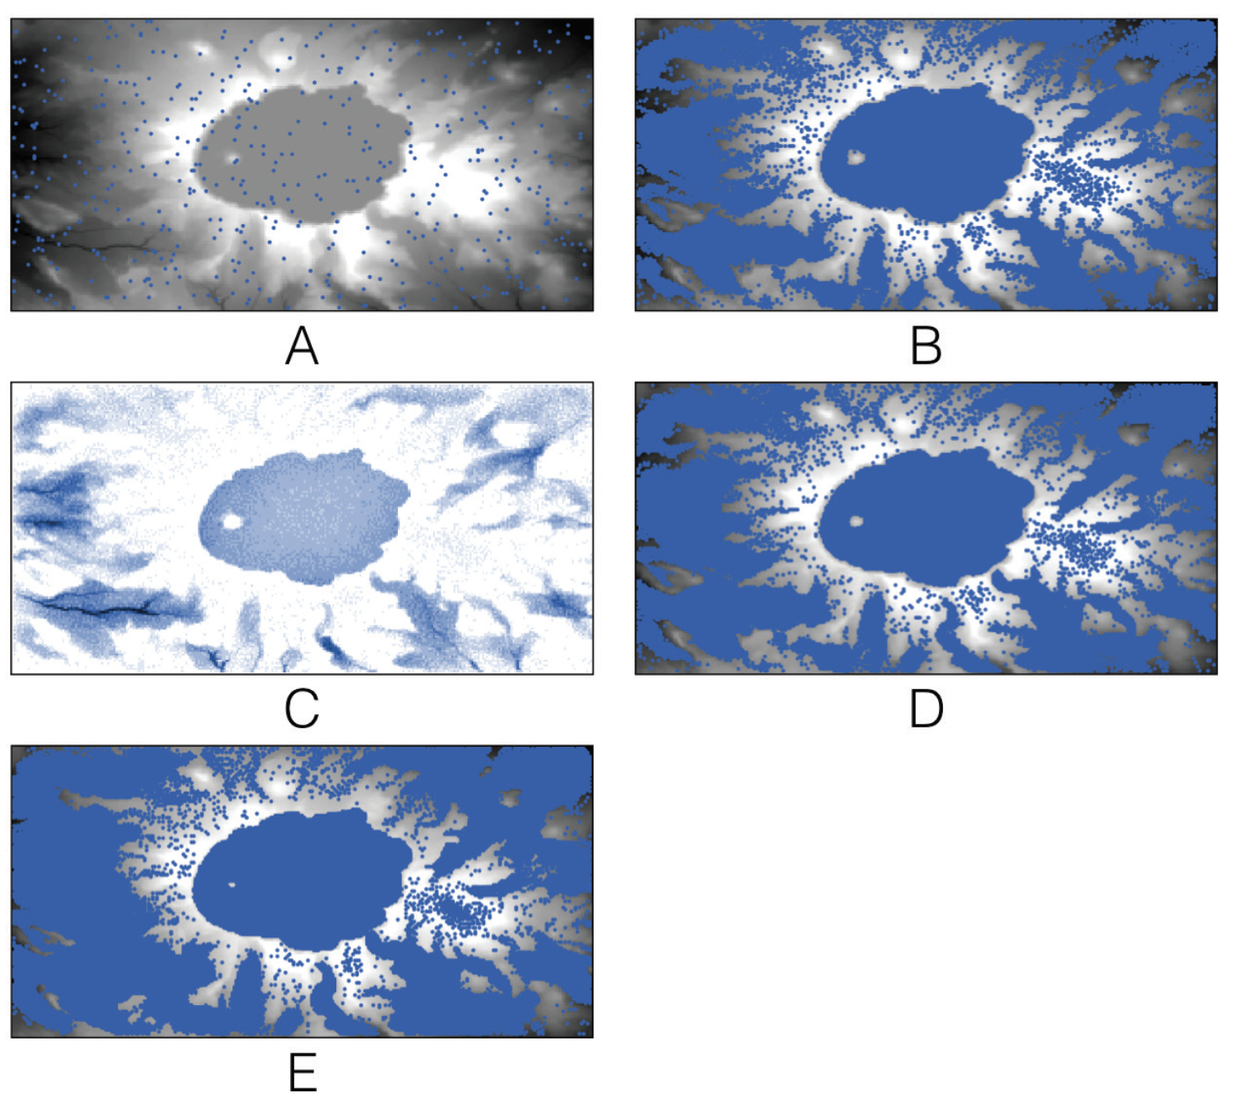
A simple hydrological model in which rain falls from the sky and flows downhill
(A) initial starting conditions where the blue dots represent agents (i.e. water) and the underlying digital elevation model;
(B) over time rain accumulates in Crater Lake;
(C) water depth at time step 500 and
(D) the corresponding water;
(E) Crater Lake has enough water for it to discharge.
Experiment with the Rainfall model, which is available in the accompanying
material. If you change the landscape (MapType) to Flat, Cone, and Hill, does the water behave as expected?
Click here to download the model

Slide 24
Detailed Raster Example: Rainfall Model
It is also necessary to define some global variables and some turtle and patch variables.
In particular, note the “elevation-dataset” global variable (this is used to store the raster GIS data) and the elevation patch variables (these are used to keep track of the initial elevation and current elevation once water starts to flow onto each patch).
Next it is necessary to read the DEM data. They are stored as an .asc file. This is a common raster format used by most GIS applications

Slide 25
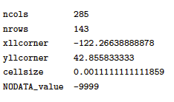
Detailed Raster Example: Rainfall Model
To load the DEM data into NetLogo it is first necessary to resize the model environment so that there is precisely one NetLogo patch per raster pixel.
It is possible to find the number of rows and columns in a raster data set using a GIS, but the process is even simpler with .asc files.
The first few lines of the file provide some information about the rest of the data. For example, the first six lines of the elevation.asc file, which we will read here, contain the following:

Slide 26
Detailed Raster Example: Rainfall Model
The first two lines declare the number of columns and rows of pixels. Therefore the NetLogo environment must be resized so that it has exactly that many rows and pixels.
In this example we would like the origin to remain in the centre of the world, hence it can be resized as follows:
resize-world -142 142 -71 71
Following this, the envelope needs to be configured so that it will map exactly on to the raster GIS data extent (refer to the gis:set-world-envelope documentation for more information).
gis:set-world-envelope gis:envelope-of elevation-dataset

Slide 27
Detailed Raster Example: Rainfall Model
Then the two apply-raster commands read the value of each raster cell and store this value in the patches’ elevation and initial-elevation variables (to begin with the elevation and initial elevation are the same because the model has not simulated any water). In effect this creates the mapping between raster cells and NetLogo patches.
gis:apply-raster elevation-dataset elevation
gis:apply-raster elevation-dataset initial_elevation

Slide 28
Detailed Raster Example: Rainfall Model
In effect “elevation” and “initial_elevation” creates the mapping between raster cells and NetLogo patches.
globals [
elevation-dataset
border ;; keep the patches around the edge in a global
;; so we don't ever have to ask patches in go
min-e ;;minimum elevation
max-e ;;maximum elevation
the-row ;;used in export-data. it is the row being written
list_of_rain_amount
]
patches-own [
elevation
initial_elevation
elevation_change
amount_rain ;;how many drops of rain here
]

Slide 29
Detailed Raster Example: Rainfall Model
Turtles are created to represent water drops and they use the height of the surrounding patches to move down hill where appropriate
turtles-own[
soil ;;how much soil a raindrop is carrying
]
And the following procedure taken from Grand Canyon Model
to flow
;;this part uses codes from the library model Grand Canyon, with some modifications
let target min-one-of neighbors [ elevation + ( count turtles-here * water-height) ]
ifelse [elevation + (count turtles-here * water-height)] of target
< (elevation + ((count turtles-here - 0) * water-height))
[ face target
move-to target ]
[ set breed waters ]
;;codes from Grand Canyon end here
end

Slide 30
Summary of Raster Data in Agent-based Models
One of the advantages with raster data is that they fit well with cell-based nature of many agent-based models.
This is especially true of the direct relationship between raster cells and NetLogo patches.
Raster data are also often widely available, especially remotely sensed data, and multiple raster layers can be combined to build rich models (as in the case of the SLEUTH example).

Slide 31
Using Vector Data in NetLogo
Vector data allows geometric detail to be incorporated into agent-based models.
Most toolkits allow for the importation of ESRI shapefiles (i.e. points, lines and polygons).
The accompanying .dbf (database) file contains the attribute data associated with each area
These attributes can be used to populate the environment

Slide 32
Detailed Vector Example: Schelling and Polygons
In this example we use polygons to replace the regular cell structure that is typically associated with Schelling Model.
The model logic is similar, though; agents have a preference for being surrounded by neighbors who are similar to themselves.
Here, the neighborhood is defined by adjacent polygons rather than the Moore neighborhood.
agents move to an unoccupied polygon if their preference is not being met.
Another important difference is that the agents are not randomly placed in the artificial world. Rather their original locations are based on information from the shapefile. In this simple example, one agent is created per polygon.

Slide 33
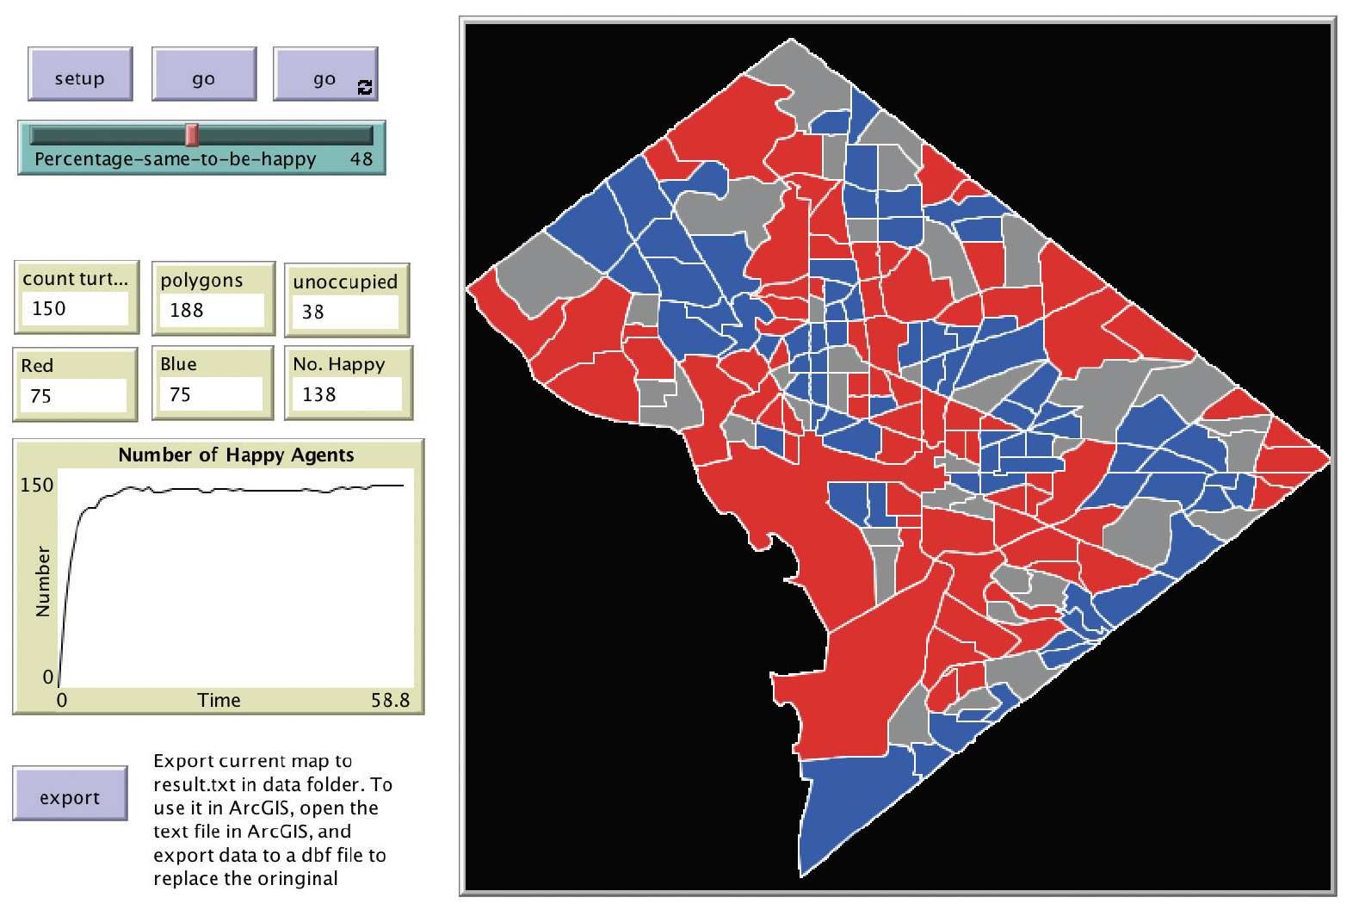
The Schelling Segregation Model Implemented using Polygons as Agents
Click here for the model

Slide 34
The Schelling Segregation Model Implemented using Polygons as Agents
For more details with working with Vector See the tutorial Associated with this chapter.

Slide 35
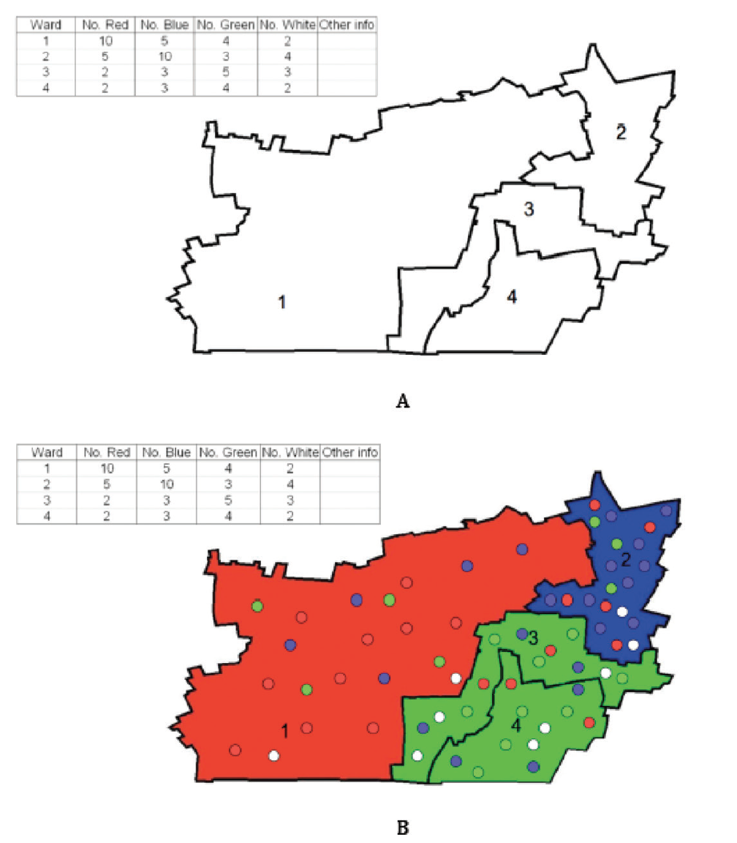
Reading in a shapefile and Creating Agents within Polygons

Slide 36
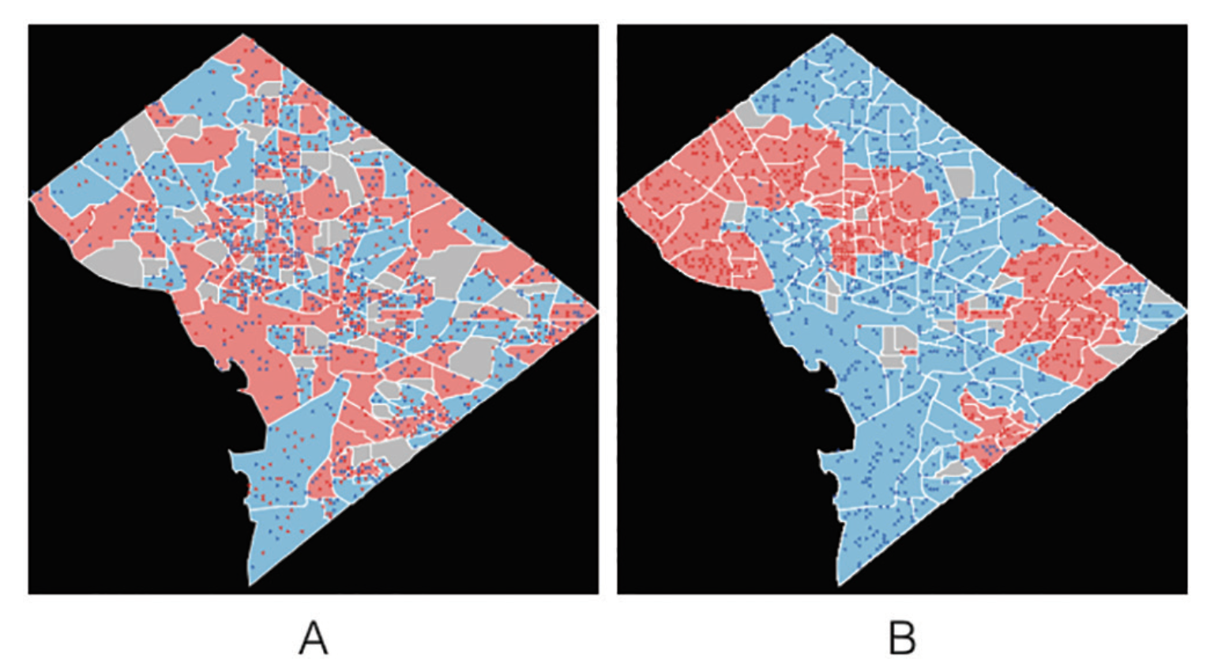
Reading in a Shapefile and Creating Agents within Polygons
(A) Instantiation of a segregation model where each agent is created from attribute information and (B) the resulting end state when all agents are satisfied with their neighborhood.
Click here for the model
Notes:
(A) Instantiation of a segregation model where each agent is created from attribute information and (B) the resulting end state when all agents are satisfied with their neighbourhood.

Slide 37
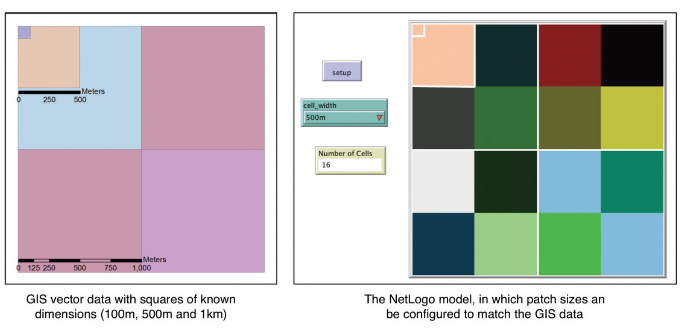
Setting the NetLogo patch size so that it Corresponds with some Vector GIS data
Click here to see the Model

Slide 38
Summary of Vector Data in Agent-based models
Box 6.8
In this section, two geographically explicit agent-based models have been
discussed. They demonstrated how models can be created using data held
within a vector GIS layer and how attributes of the GIS data can be used to
create agents. Many more complex examples and more applied models can
be created using the same techniques, some of which are outlined in
Appendix A. The use of vector data in a GIS will be revisited in Section 8.4,
where it will be demonstrated how agents can move around a road network.

Slide 39
Summary of Raster Data in Agent-based Models
One of the advantages with vector data is that it captures geometric details .
Agent-based models can be created using data held within a vector GIS layer and attributes of the GIS data can be used to create agents.

Slide 40
Exporting Data
While imparting data into agent-based models is important, so is the exportation during and after the simulation has been run.
Some agent-based modelling packages (e.g. Repast and MASON) provide tools to create new shapefiles, while all support some sort of export functionality – the simplest of these being the ability to create plain text (.txt) files

Slide 41
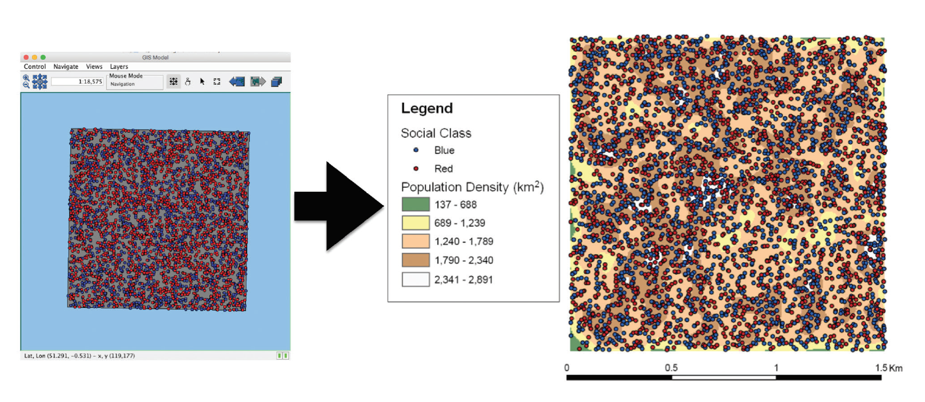
An Example of Taking Attribute Data from a Model and then Exploring it in a GIS.
Here, agents are exported from a RepastJ model of segregation as a point shapefile. Their locations are then used to calculate the population density using ArcGIS

Slide 42
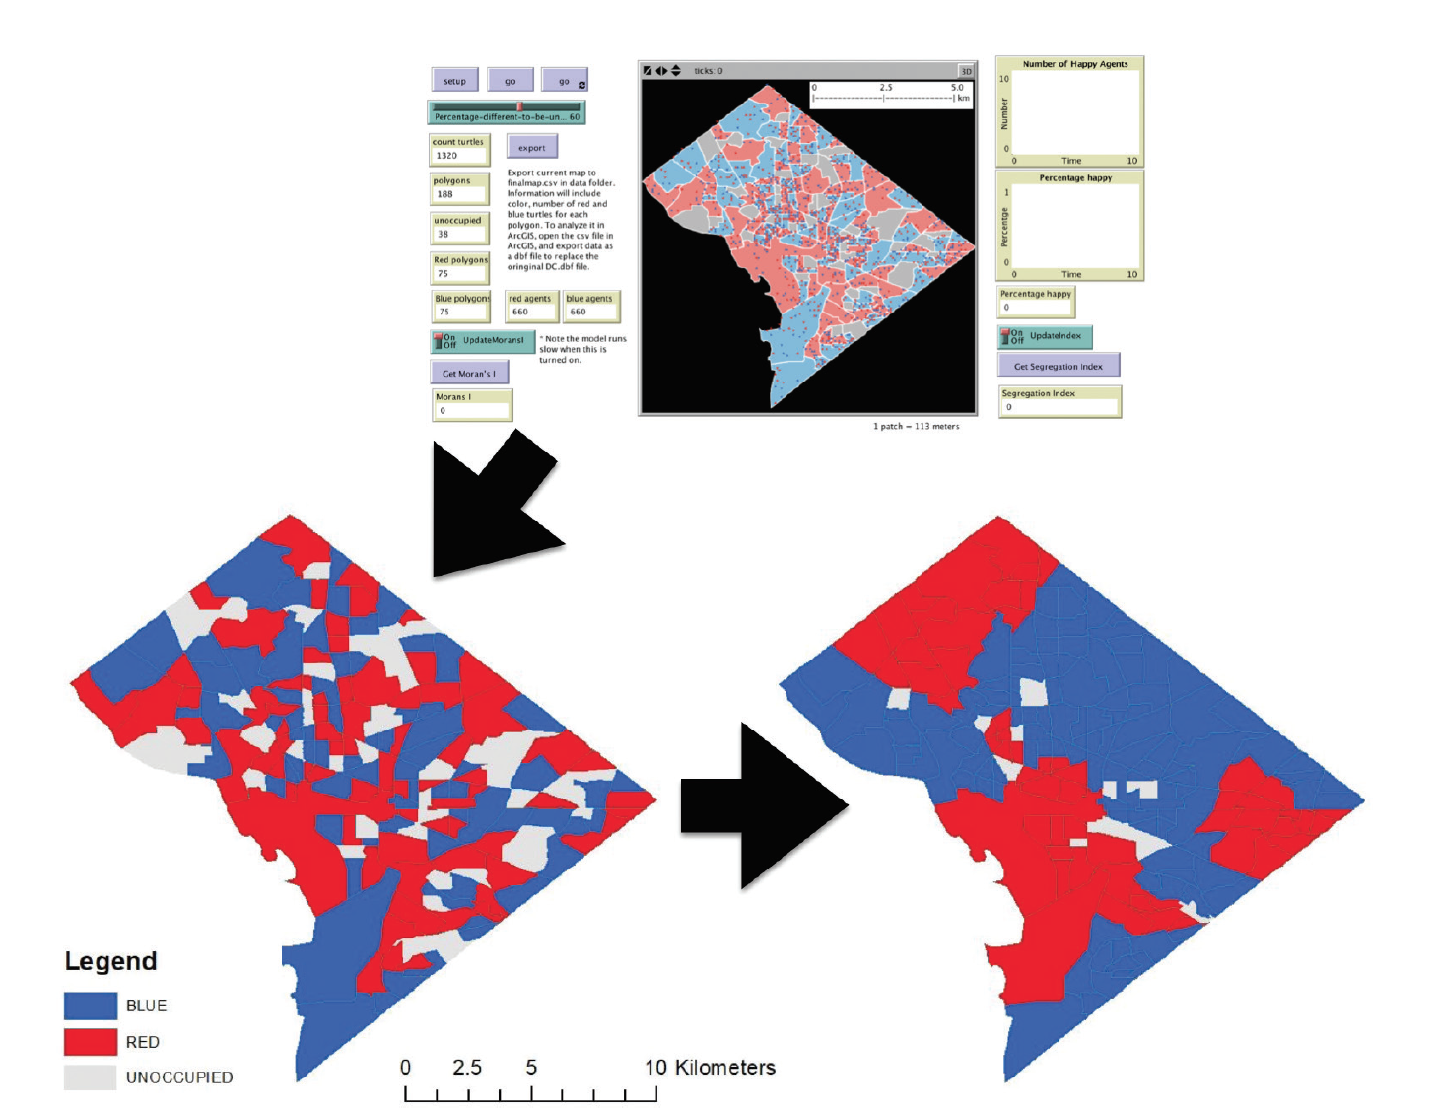
Exporting Data: Segregation Model (Points)
An example of taking attribute data from the NetLogo Schelling model and displaying it in a GIS.
Agents are exported from the Schelling model as a .txt file at the start and end of the simulation.
They are displayed in a GIS. Initially there are 1320 agents distributed over 118 polygons (of which 75 are blue, 75 are red, 38 are unoccupied).
Each agent has a preference to be in an area where 60% of their neighbors are of the same color.
Over the course of the simulation this results in agents moving and altering the population and colors of the polygons (114 blue, 58 red, 16 unoccupied).

Slide 43
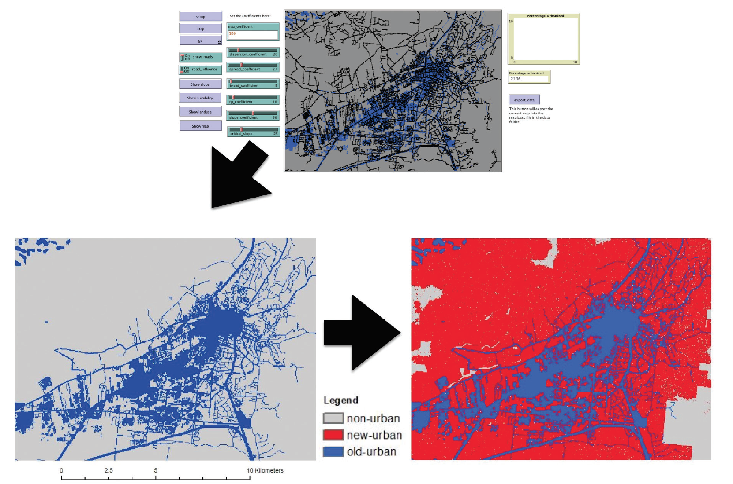
Exporting Data: Urban Growth
Exporting raster data from a simple urban growth NetLogo model and visualizing it in a GIS for further analysis. In this example the model ran for 100 time steps and the area urbanized went from 21% to 92%
See Urban Growth Model
Notes:
Exporting raster data from a simple urban growth NetLogo model and visualising it in a GIS for further analysis. In this example the model ran for 100 time steps and the area urbanised went from 21% to 92%

Slide 44
Discussion
This chapter has highlighted the ability to import and export geospatial data in both raster and vector formats (via a loose coupling approach).
Both types of formats have their advantages and disadvantages.
E.g., topological calculations (such as neighborhood calculations, the distance between two points, and point-in-polygon operations) are expensive in terms of execution speed, thus limiting the performance of a vector-based model.
By adding real-world geographical information to agent-based models we now not only have the ability to model actual decision-making units such as individuals, households but also can account for the influence of specific local conditions.
GIS data can be used to create artificial populations and agent descriptions based on data about the area under investigation

Slide 45
Further Reading
More information about GIS functionality in NetLogo readers are referred to: https://ccl.northwestern.edu/netlogo/docs/gis.html along with the NetLogo GitHub page: https://github.com/NetLogo/GIS-Extension
While the website Simulating Complexity https://simulatingcomplexity.wordpress.com/2014/08/20/turtles-in-space-integrating-gis-and-netlogo provides a good tutorial on integrating GIS into NetLogo.
Key texts about the integration of GIS and agent-based modelling, readers are referred to:
Crooks, A.T. and Castle, C. (2012), 'The Integration of Agent-Based Modelling and Geographical Information for Geospatial Simulation', in Heppenstall, A., Crooks, A.T., See, L.M. and Batty, M. (eds.), Agent-based Models of Geographical Systems, Springer, New York, NY, pp. 219-252.
Maguire, D.J., Batty, M. and Goodchild M, F. (eds.) (2005), GIS, Spatial Analysis and Modelling, ESRI Press, Redlands, CA.
Westervelt, J.D. (2002), 'Geographic Information Systems and Agent-Based Modelling', in Gimblett, H.R. (ed.) Integrating Geographic Information Systems and Agent-Based Modelling Techniques for Simulating Social and Ecological Processes, Oxford University Press, Oxford, UK, pp. 83-104.

Slide 46
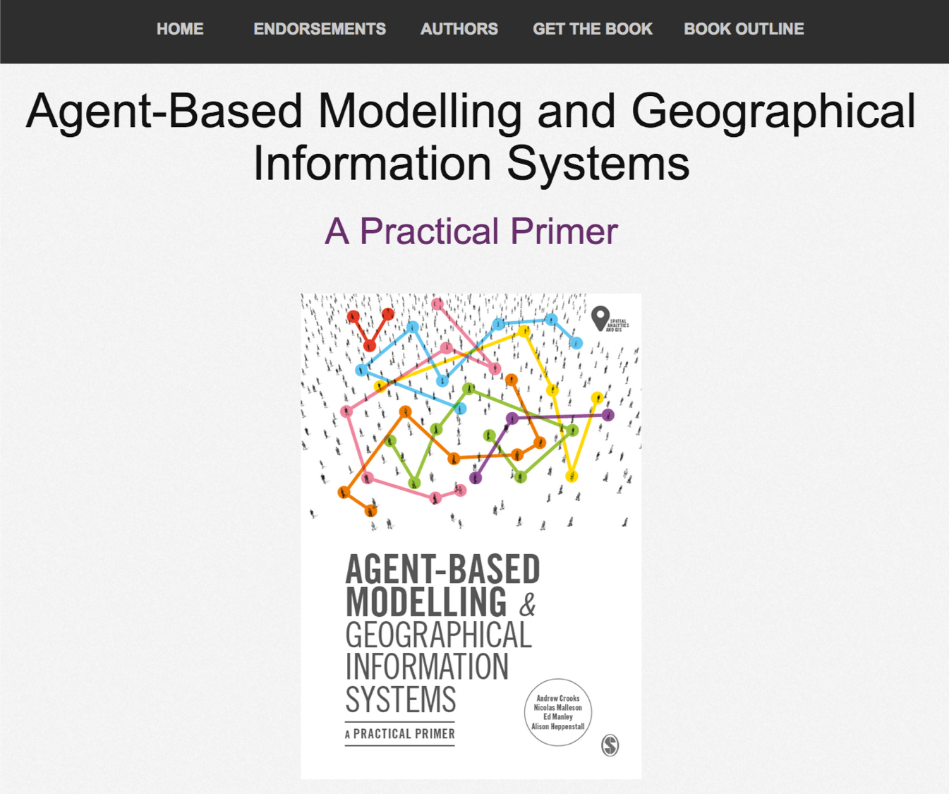
Online Resources
Visit: https://github.com/abmgis/abmgis/tree/master/Chapter06-IntegratingABMandGIS for a selection of models to highlight core concepts introduced in this chapter along with a tutorial.

